Slide 1




Anuj Sharma
Postdoctoral Associate at University of Florida
anujsharma@ufl.edu

Slide 2

Sequence analysis Pipeline development
Open source
Visualization Statistical modeling

Slide 3

Bioinformatics
Application of computer/ computational technologies on biological data
Raw biological data
↓^{bioinformatics}
Meaningful information

Slide 4
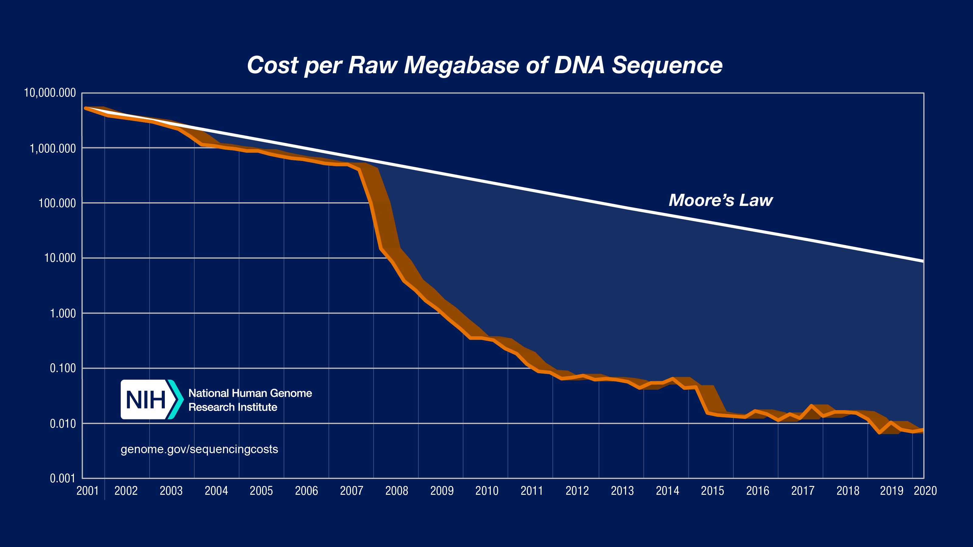

Slide 5

😃 Cheaper sequencing
⇩
🫤 More sequence data
⇩
🤔 Extract meaningful information
⇩
😀 Computational approach
⇩
🤑 Bioinfomatics [Computational biology]
⇧
😱 Limited computational resources

Slide 6
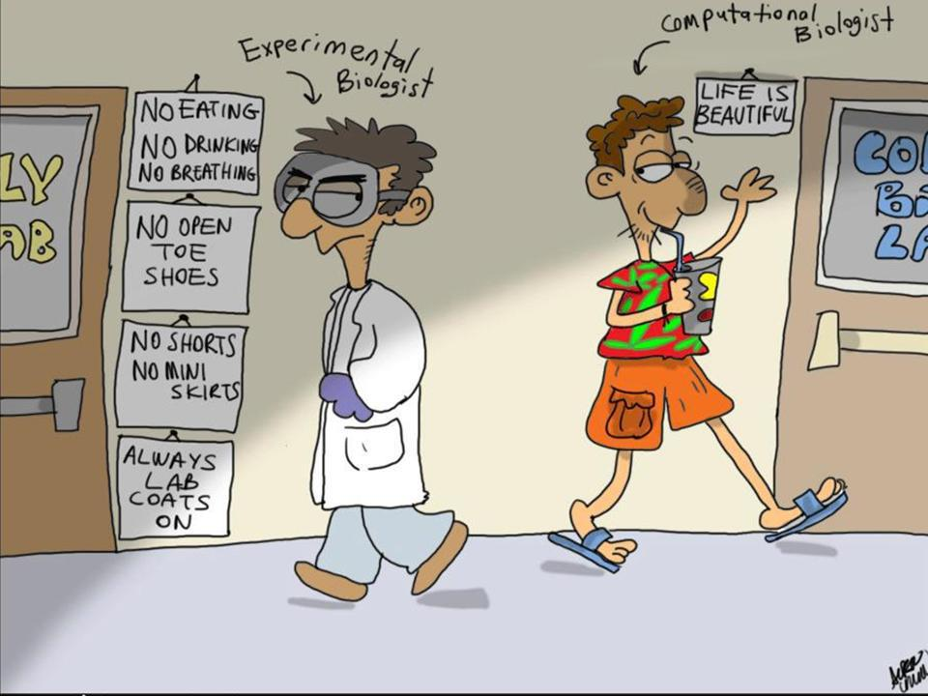

Slide 7



Slide 8

Unix system
Open source
Preferred by software developers
Often best support
Dominant system for large scale computers (servers and clusters)

Slide 9

Command Line
Commands are typed in.
No interaction with visual elements No buttons, no clicky-clicky
Older than GUI, but more powerful
Lower level interactions
Less processing power
Good for programmetric use
Most bioinformatic tools are written for commandline interface
I ❤️ #!/bin/bash

Slide 10
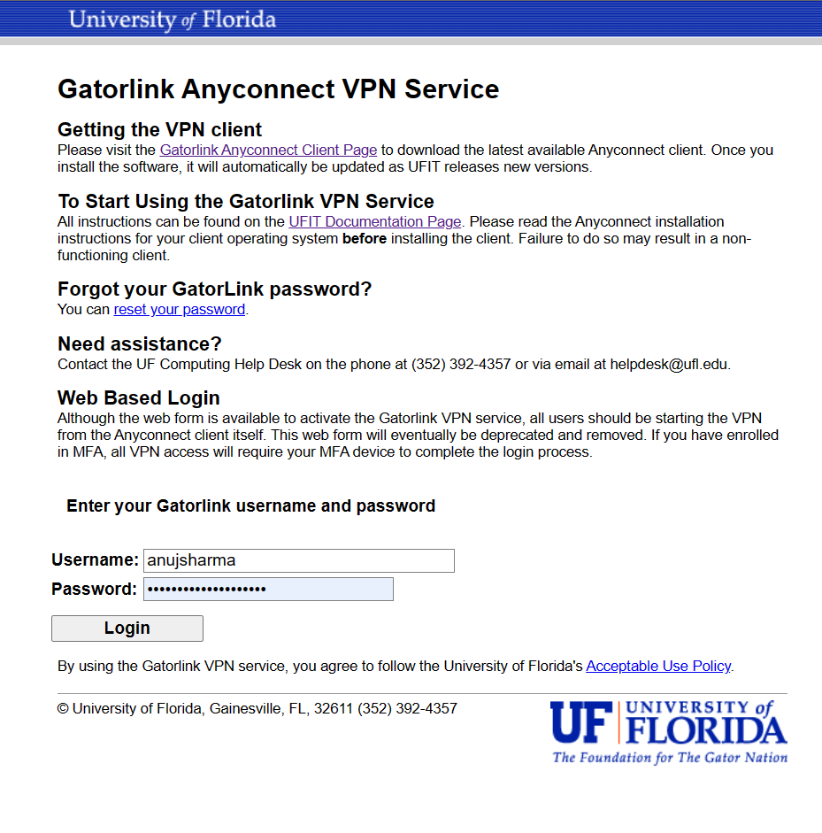

Gatorlink VPN
Go to vpn.ufl.edu
Fill in your username and password
Click login

Slide 11


Slide 12

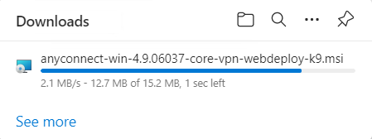

Slide 13
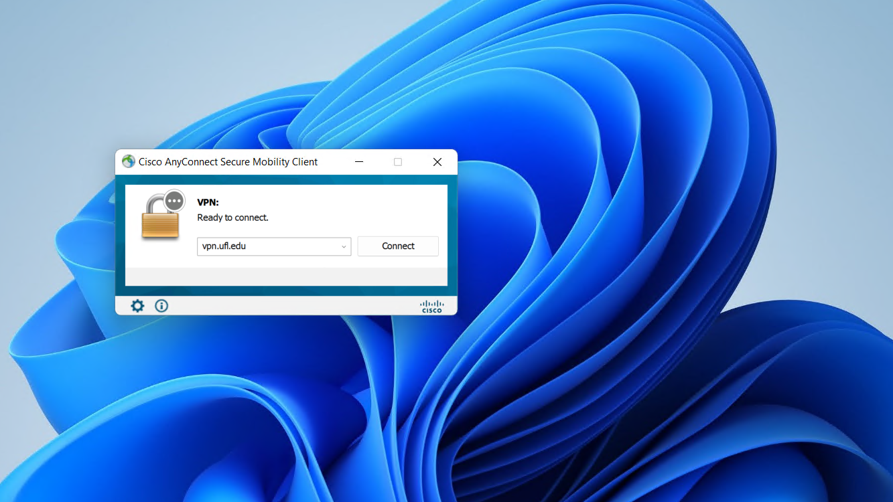

Slide 14
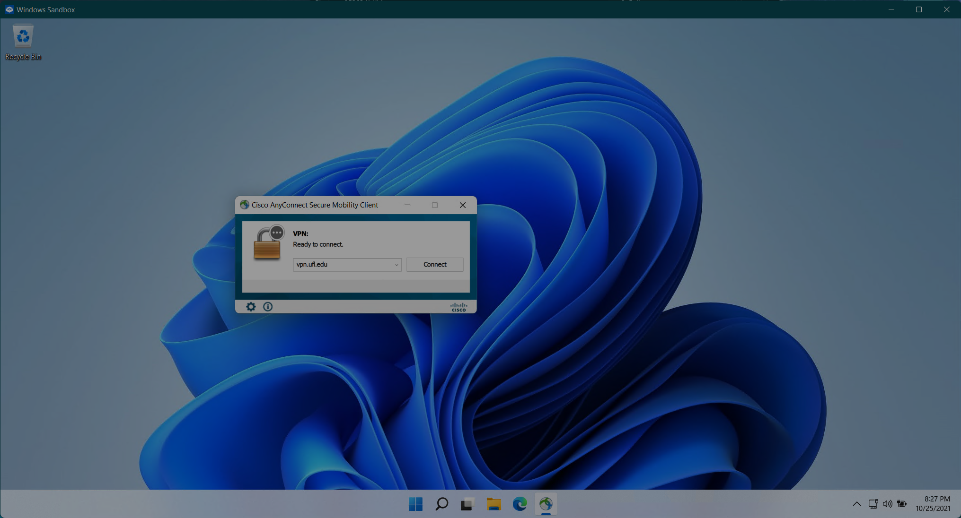
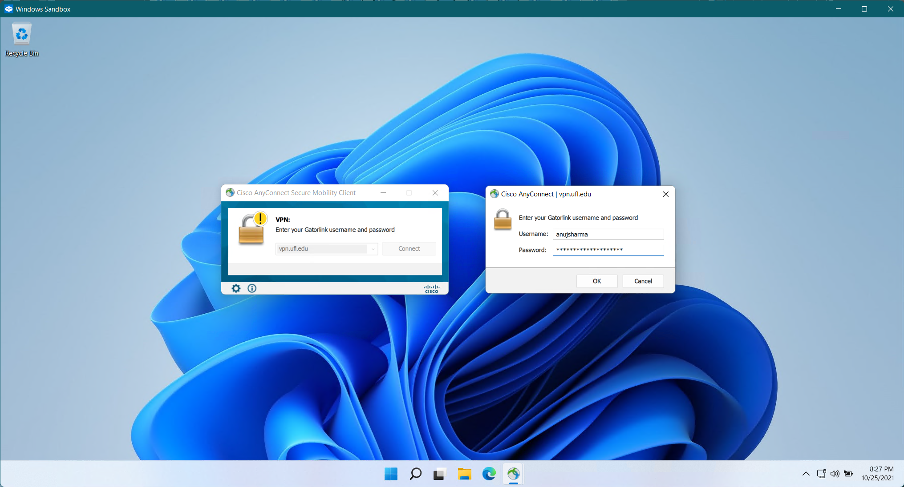
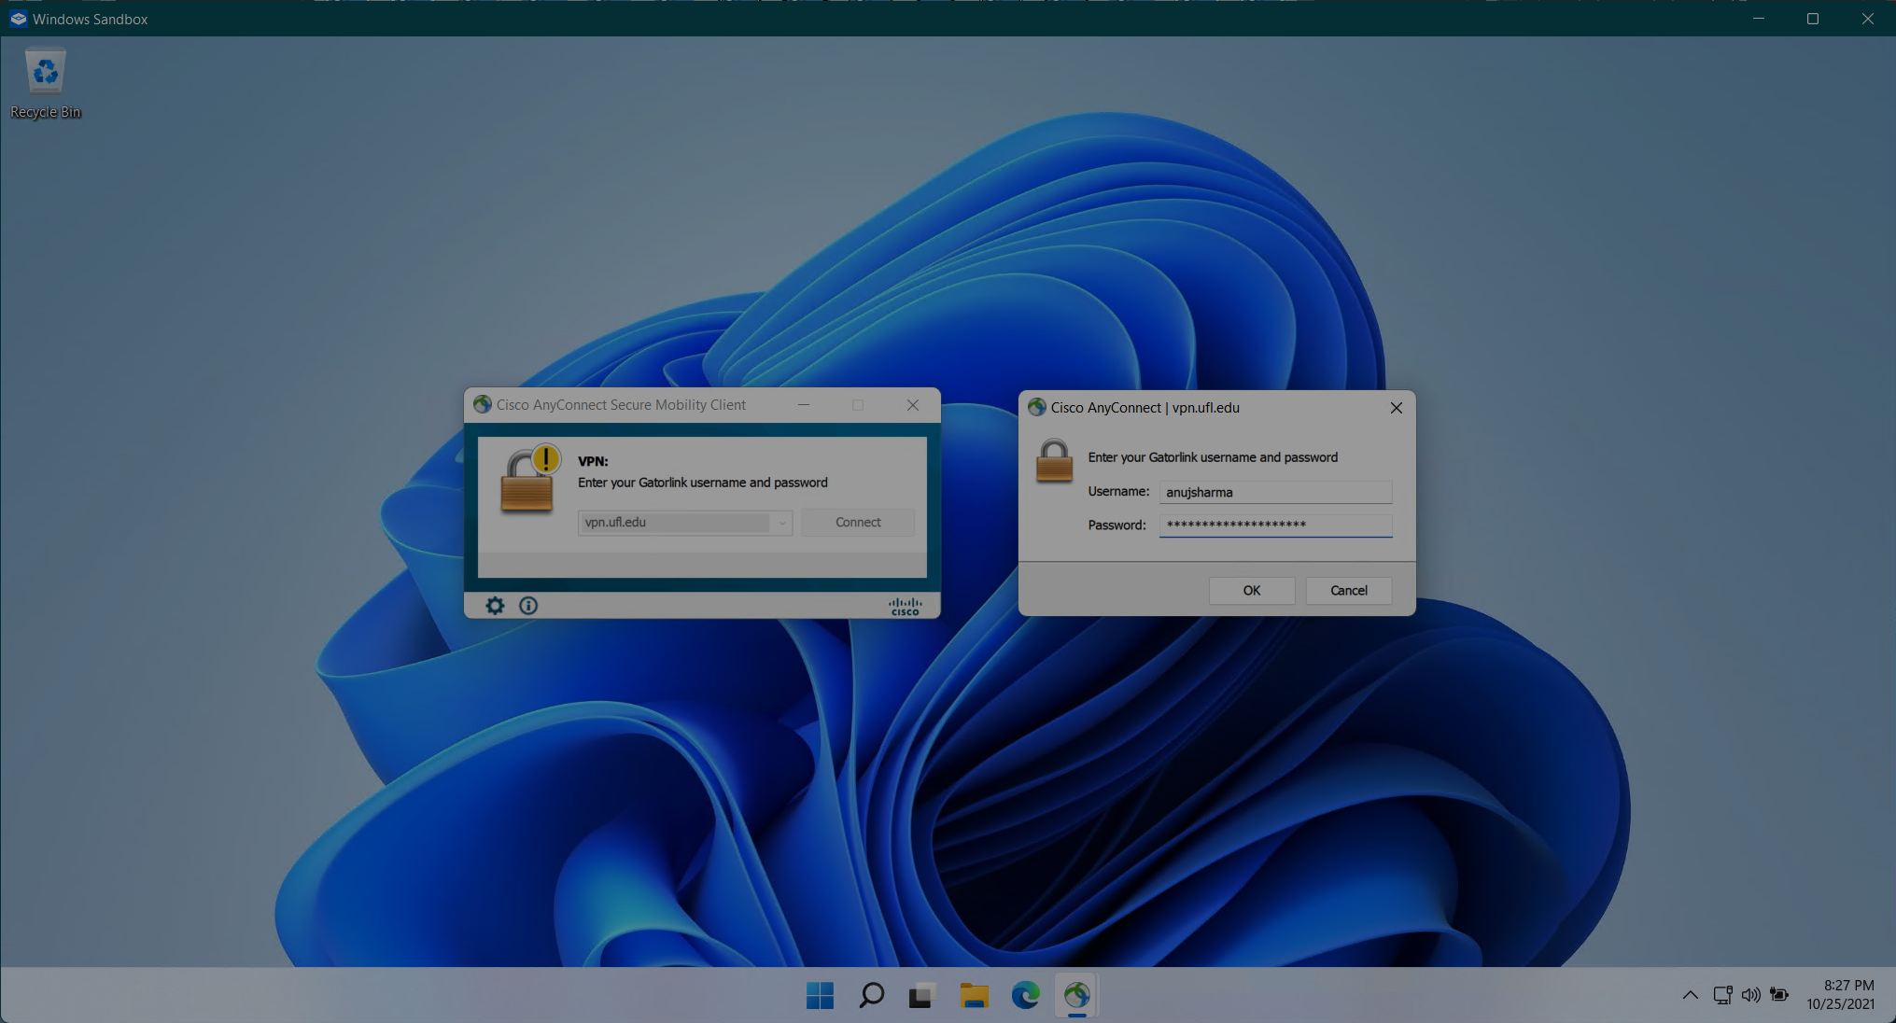

Slide 15
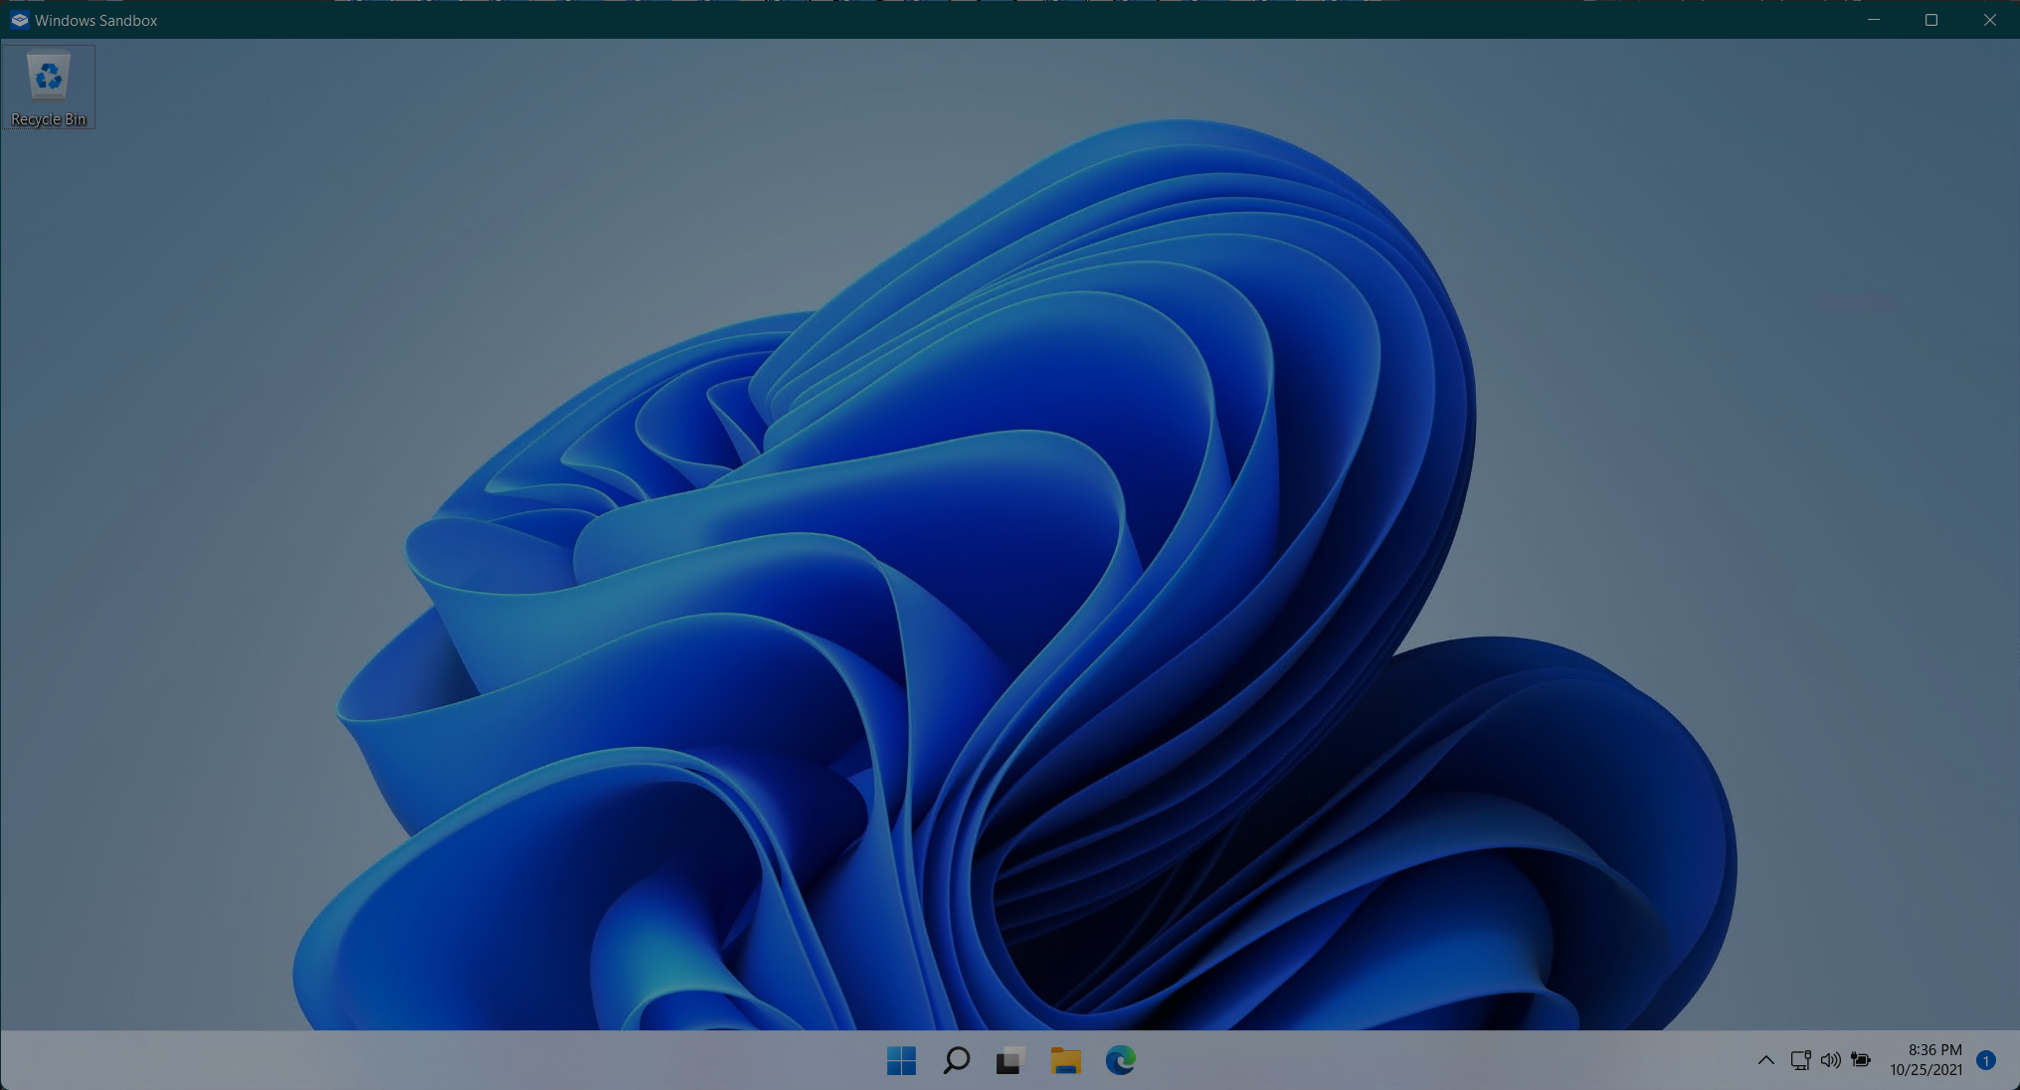
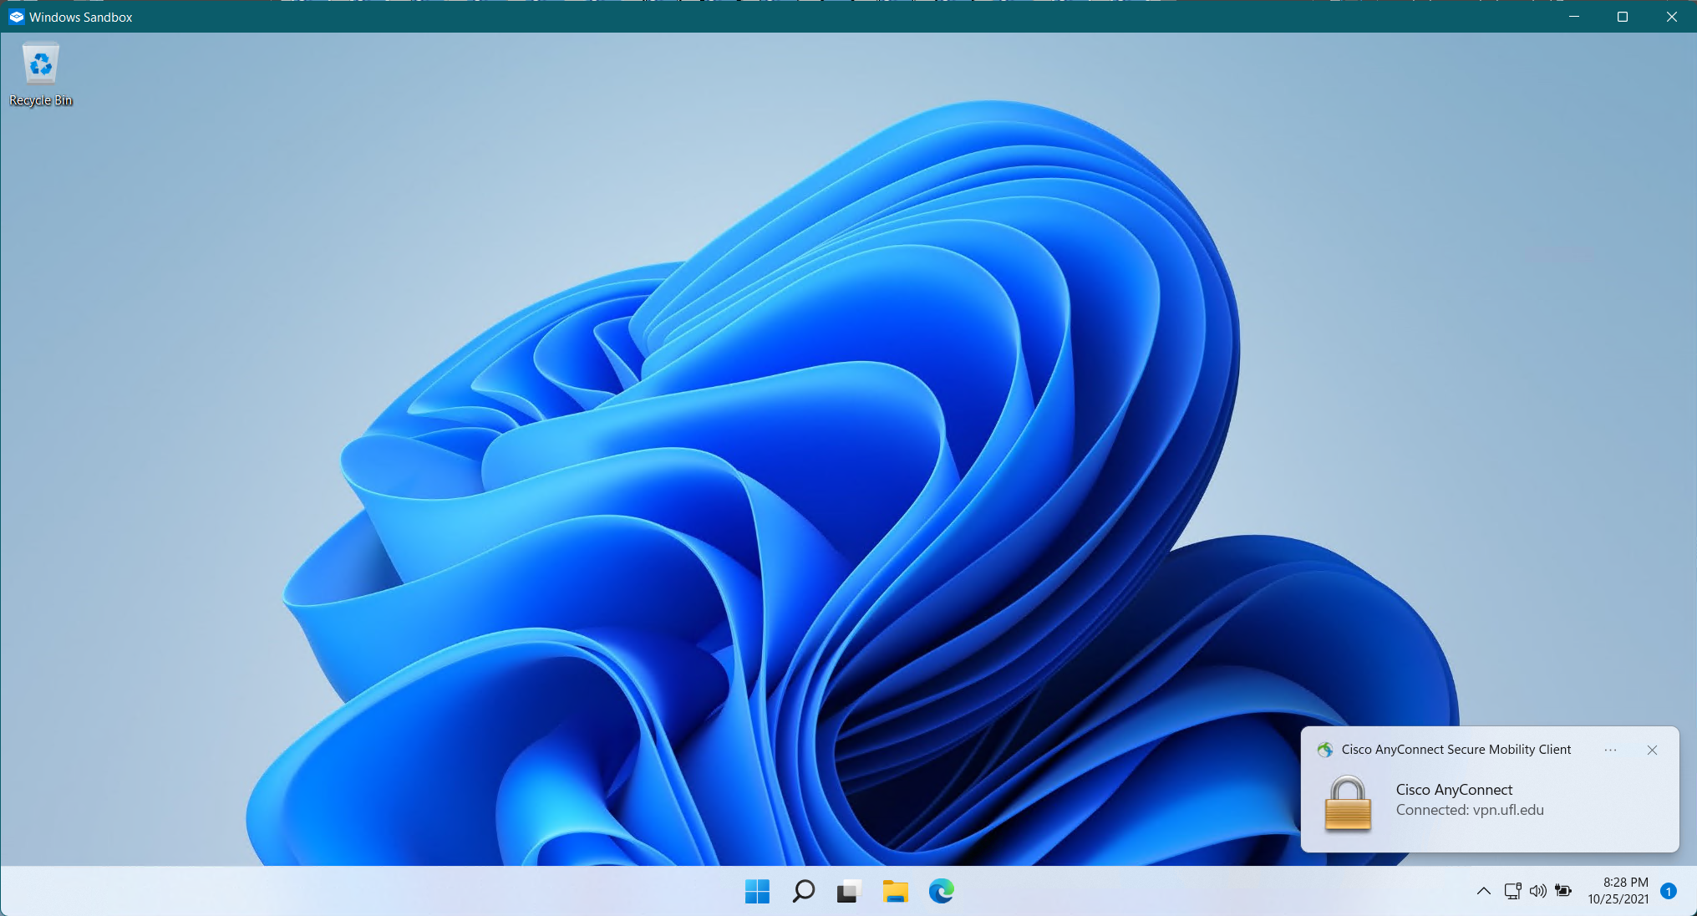

Slide 16
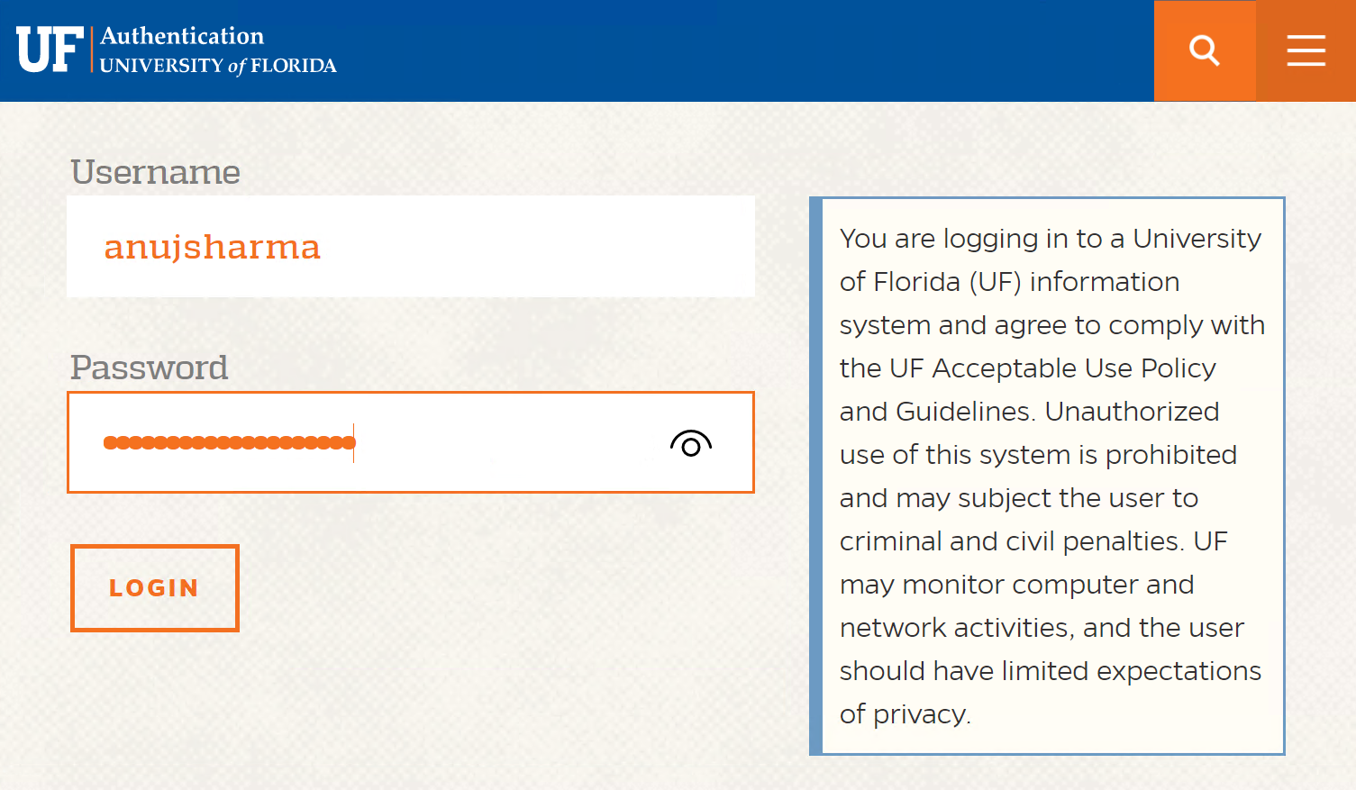
UFRC OnDemand
Go to ood.rc.ufl.edu
Enter your credentials
Click Login

Slide 17


Slide 18
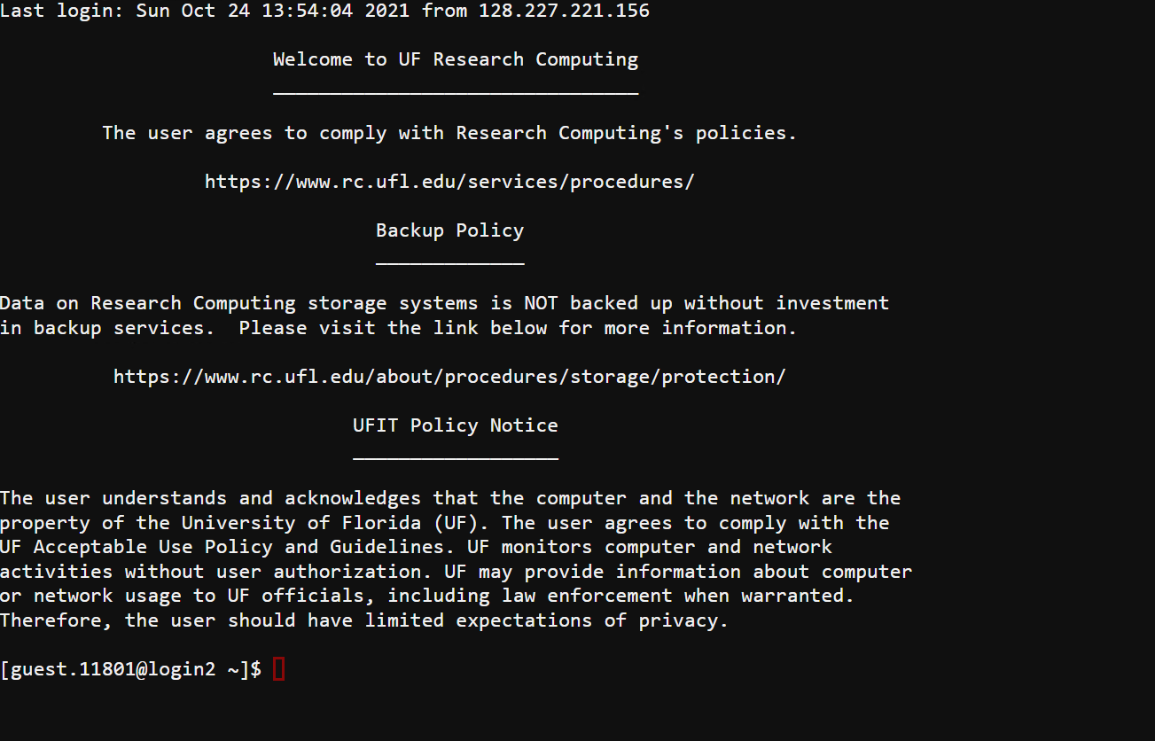
anujsharma

Slide 19



Slide 20
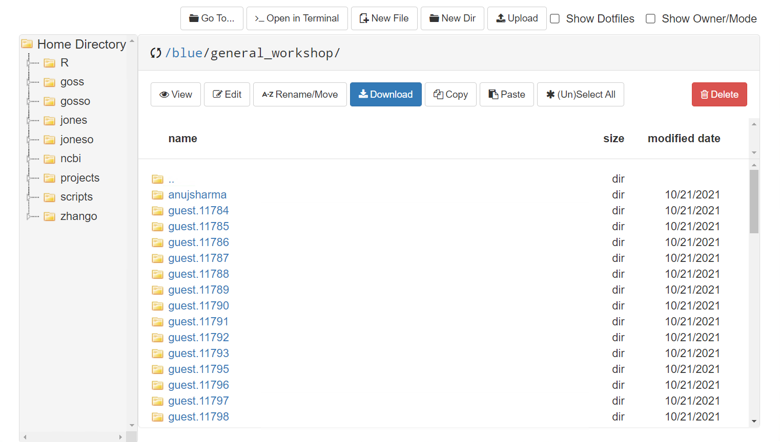


Slide 21
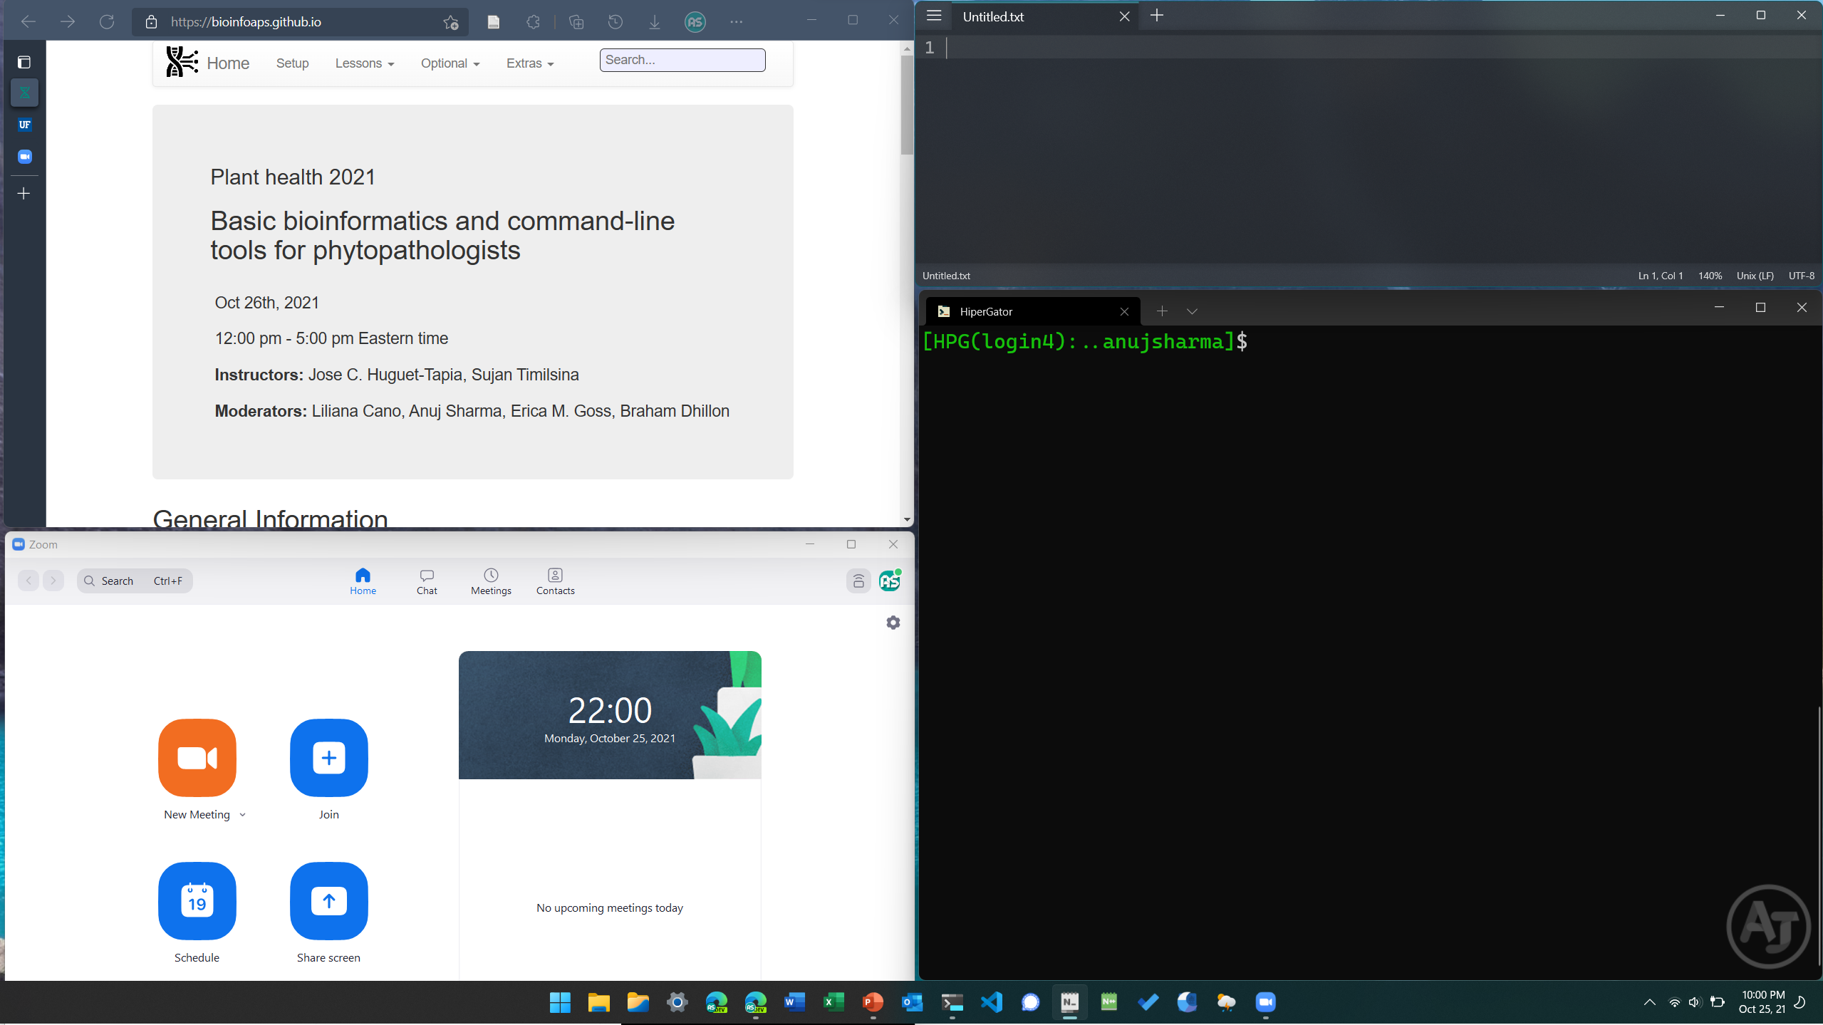
Webpage
Notepad
Terminal
Zoom

Slide 23
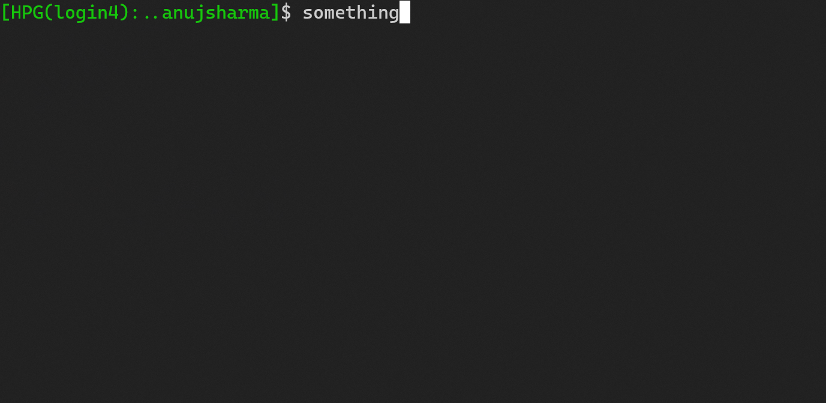
Navigating in CLI
Mouse click does not change cursor position. Use arrow keys ← and →.
Use Home to jump to front of line and End key to jump to back of line.
Cursor
Home
→
→
→
→
→
→
→
→
→
something
→
→
→
→
→
→
→
→
→
End

Slide 24
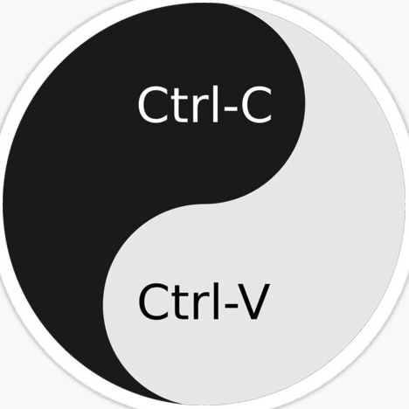
Navigating in CLI
Use Ctrl+C (macOS: Cmd+C) after selecting some text for copying the text.
Use Ctrl+V (macOS: Cmd+V) for pasting copied text.
Use Tab for autocompletion, e.g., for filenames.

Slide 25
Navigating in CLI
Use ↑ to view previous commands.
Pressing ↑ further will reveal older commands.
Use ↓ to go back to newer commands.
Use Ctrl+L to clear the screen.

Slide 26
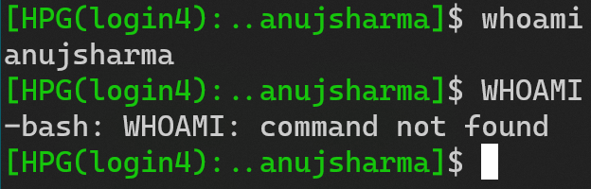
Unix is case-sensitive
Command ≠ command
This applies to both commands and filesystem.
DON’T
Caps Lock
AT ME

Slide 27
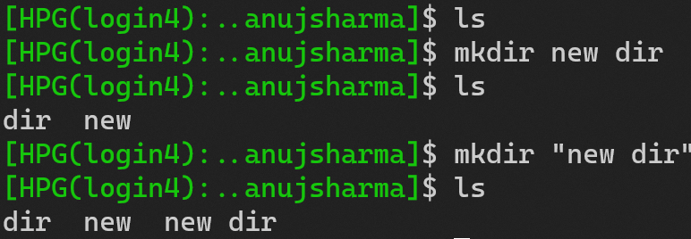


Reware of space
Avoid space in filenames if possible.
If necessary, enclose space within quotes (“” or ‘’) or escape with backslash (\).
Say NO to space

Slide 28

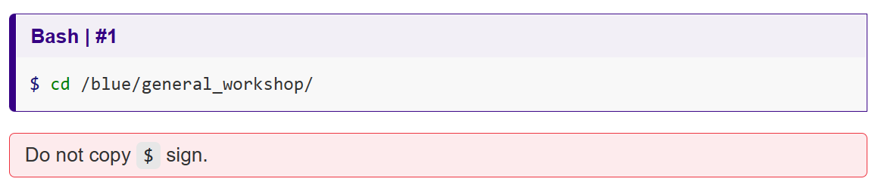
DO
Copy the command from website instead of typing. (Most error result from mistype)
Type command sequenctially as shown in webpage. (Output might vary otherwise)
DON’T
Copy the $ sign. (It is there to indicate bash shell)
You’re ready to type your first command!

Slide 29
Help us help you
Report command number when asking for help.
This is the command number for the section.

Slide 30

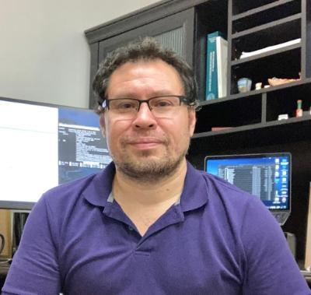
Notes:
Research Scientist @ UF Plant Pathology
Work extensively in diverse aspects of bioinformatics.

